Slide 1
Industry Session:
Business Customer Gateway and Postal Wizard
2023
Notes:
Good afternoon! My name is NAME and I am a Business Solutions Training Developer for the Postal Service. Thank you for joining us on this series designed to help customers with submitting postage statements electronically. This is a bi-weekly series that will alternate between a Business Customer Gateway overview with Postal Wizard tutorial and a session with an Intelligent Mail for Small Business Tool tutorial. This week will be going over the BCG and PW tutorial.
This presentation can be found in PostalPro.
We would love to hear from you so, if you have any questions, please feel free to input them in the chat box.
We would like to remind our Postal Service colleagues that if you have any questions, please send it to our email. We would like to have the chat open for our Industry customers.
We will be covering:
General overview BCG
MID/CRID and common USPS terms
Sign up for the site
Navigation
Services
Then we will go into entering a postage statement via Postal Wizard.

Slide 2
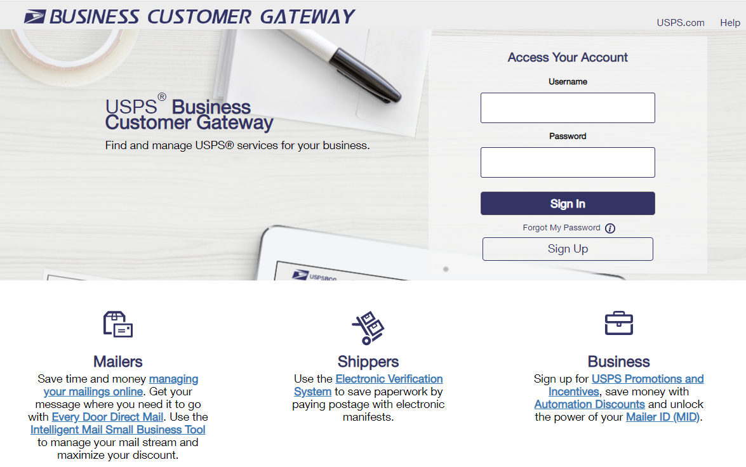
What is the Business Customer Gateway (BCG)?
The Business Customer Gateway is a secure portal to gain access to mailing and shipping services. These services are accessed through the BCG but are distinct from the site itself.
Please see the example below to see how it works.
User goes to Additional Services and clicks on the link for EPS.
The user is now in the EPS application and has left the BCG.
User logs into the BCG
Notes:
The Business Customer Gateway or BCG for short, is a single-entry point portal or “Gateway” to access online services and applications. Users can access Intelligent Mail® products and services, including PostalOne!, Facility Access and Shipment Tracking, Mailer IDs, eInduction and tracking.
Access to multiple services is provided through a single username and password.
The BCG is a secure portal, for these services and even though they are accessed thru the BCG, the user is taken to a different application. Facility Access Shipment Tracking (FAST) is one example, Enterprise Payment System EPS would be another…hence the name “Gateway” .
The first user that creates a BCG username or the first to request access to a Business’s Location, or CRID (Customer Reference ID #), becomes the BSA, Business Service Administrator for that location. Also, for some services within the BCG, the first-person requesting that service will become the BSA of that service. So it may be that a there is a different BSA for a service than the BCG BSA designee.

Slide 3
Common BCG Terms
Terms | Acronyms | Definitions
Business Customer Gateway | BCG | A secure portal to access mailing, shipping and additional mailing services via a single username and password. Provides a single point of entry for several USPS® online business services. BCG can have many CRIDs.
Customer Registration ID | CRID | A USPS-generated numeric code up to 15 digits that uniquely identify a business at a location. Use a CRID (company identifier) to establish a Business Customer Gateway account. A CRID can have many permits. A permit is owned by a single CRID at any given time.
Mailer ID | MID | Unique ID number to identify a Mail Owner, Mailing Agent, or Mail Service Provider Embedded in an IMb MIDs are either 6 or 9 digits based on calendar year mail volume in PostalOne! A CRID can have many MIDs. A MID can only be assigned to one CRID.
Business Service Administrator | BSA | Usually, the first person to request service for a business location becomes the BSA of that service and can manage others user's access. Has Managed Mailing Activity. Required to manage permits in BCG.
Business Service Administrator Delegate | BSA Delegate | Acts on behalf of the BSA; can revoke or approve users' access. Has Managed Mailing Activity. Required to manage permits in BCG.
Managed Mailing Activity | MMA | Site of core services, manage permits, balances and fees.
Notes:
Business Customer Gateway - A secure portal to access mailing, shipping and additional mailing services via a single username and password.
Customer Registration ID – it’s a numeric code that uniquely identify a business at a location.
Mailer ID – a unique 6- or 9-digit ID number that identifies a Mail Owner, Mailing Agent or a Mail Service Provider.
Business Service Administrator - Usually, the first person to request service for a business location becomes the BSA of that service and can manage others user's access.
Business Service Administrator Delegate - Acts on behalf of the BSA; can revoke or approve users' access.
Managed Mailing Activity - Site of core services, manage permits, balances and fees.

Slide 4
CRID Management
What is a CRID?
A Customer Registration Identification number (CRID) is a USPS-generated numeric code of up to 15 digits that uniquely identifies a business at a specific location. Customers must have a CRID assigned to their business location to be able to access their permits and services in BCG, submit electronic documentation (eDoc), claim Nonprofit rates, and receive Full-Service benefits.
Using an Existing CRID when registering on the BCG
While customers may have multiple CRIDs due to multiple locations, it is better for the postal service, as well as the customer, to limit the number of CRIDs to the bare minimum. Newly created permits should be linked to an existing business location CRID whenever possible.
Customer Registration ID (CRID) Management Fact Sheet (usps.com)
CRID Look-up Options for Mail Service Providers (MSPs)
Registered Mail Service Providers (MSP) can conduct queries to find customers CRIDs and MIDs by using the MID/CRID Lookup tool, MSPs can limit the creation of new CRIDs by finding existing ones for their customers. If they do not have any, then this tool will allow the MSP to create CRIDs as needed, without creating additional unneeded CRIDs.
Customer Registration Identification (CRID) and Mailer Identifier (MID) Acquisition Fact Sheet (usps.com)
Notes:
This is information from the CRID Management Fact Sheet (found on PostalPro).
READ slide.
Ways to Avoid Creating Additional CRIDs
Customers often create new Business Customer Gateway accounts when new employees join their company or there is a change in leadership.
New BCG users register their accounts using the existing company CRID by clicking on “Company Identifier” (shown below) when finding the company address:
Remembering their BCG Password - Whenever a new BCG account is created, a new CRID will be assigned to that BCG account unless the “Company Identifier” button is selected during account creation. Keep all BCG passwords in a safe, memorable place to avoid having to create a new account.
If you do not know if you have a CRID or what it is, you can contact the Mailing & Shipping Solutions Center (MSSC) or the BMEU where the permit is held to search for an existing CRID
For MSPs, they can check with the customer to determine if they have an existing CRID and to use the Customer Validation Tool or CRID/MID Lookup if they are unsure of their information.

Slide 5
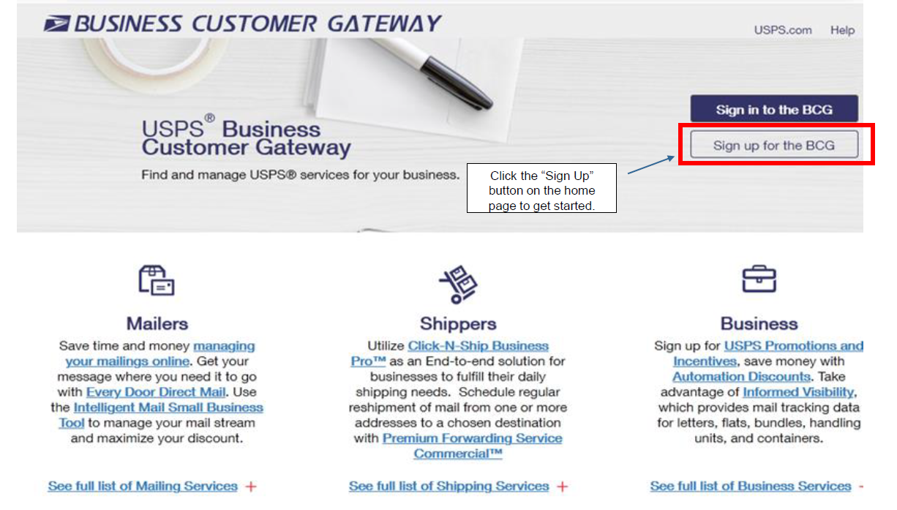
BCG Sign Up
USPS Business Customer Gateway
Notes:
Website is https://gateway.usps.com/eAdmin/view/signin
Sign into the BCG if you have an existing account. Otherwise, click on Sign up.

Slide 6
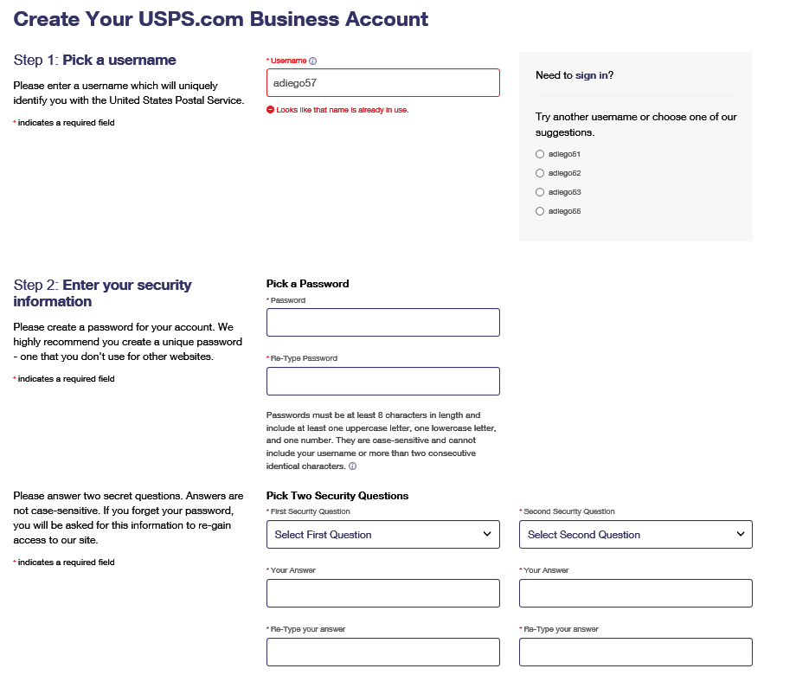
BCG Registration – Initial Steps
1
“If” a customer previously has created a BCG username, they may be prompted to create a New username.
2
Select two security questions from the dropdown menus and enter your answers for both.
Tip: Write down your username and password and security questions and answers – in a safe location of course!
Notes:
1. Pick a username and 2. a password that will be easily remembered. Store your Username & Password in a secure location.
Sometimes customers get locked out of their BCG; Or maybe they don't remember their password or security questions. The BCG will display a message that the user has been locked out and try back in 5 minutes; 10 ,minutes, 15minutes….
If you are unable to remember the password or the security questions, you will need to create a new username. If the username already exists, the system will give options to update the username.
Also, if creating a new username, the customer email will already be in the system. To get the account created, you will have to use a different email (can make a slight change to the email address. Then once the username has been accepted, you will go into Manage Account and edit their email address).
Select two security questions from the dropdown menus. Enter your answers for both questions. Store your answers in a secure location.

Slide 7
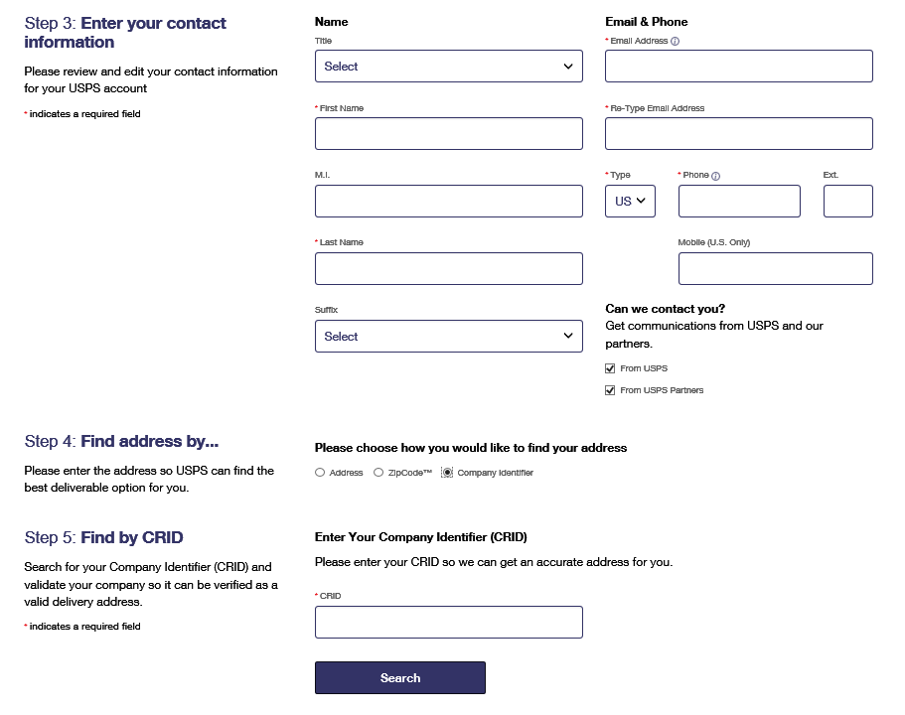
BCG Registration – Continued
3
4
*If you have an existing CRID, then click “Company Identifier” and enter your CRID
5
When your information is filled out, click here*
Notes:
3. Enter your contact information. If you do not wish to allow USPS and/or its partners to use this information to contact you, uncheck the boxes accordingly. Both will be checked by default.
Begin step four by checking the radio button indicating how you would like to find your address. If your business already has an existing USPS CRID (Customer Registration ID), select Company Identifier and enter your existing CRID number and click search. Otherwise select Address or ZIP Code and enter your address information.
If you have a permit, then you should have a CRID. The local BME or MSSC can assist in finding the CRID.

Slide 8
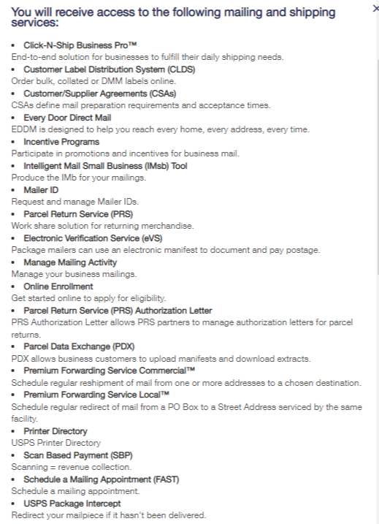
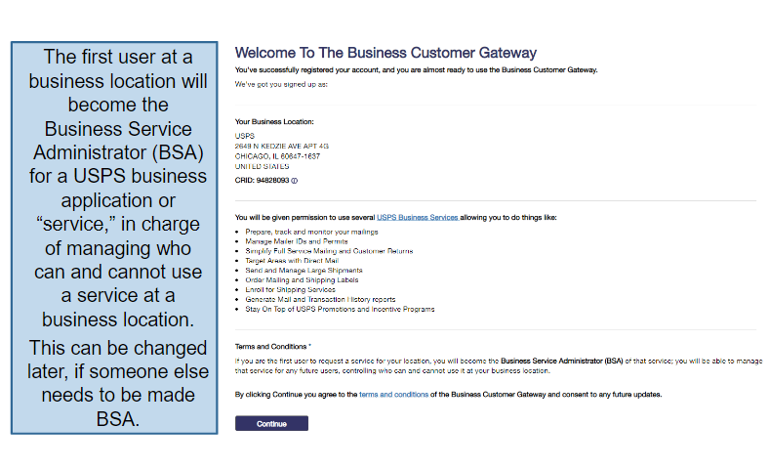
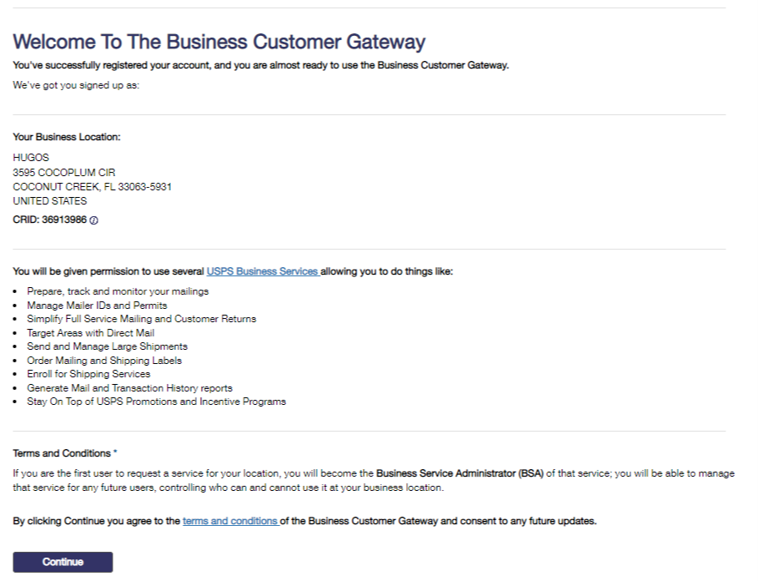
BCG New User Registration
Business Location CRID
Services
BSA Acknowledgment
Notes:
Once you have created the Username and password and the system has found your address, you are registered on the BCG. Next you will select your services and user level is assigned. Remember that the first user in the BCG for a CRID will become the BSA. Any new users after that will have to request access to services for that CRID that the current BSA will approve.
The box to the right shows you all the services granted to the first user/BSA.
Click Continue to complete registration.

Slide 9
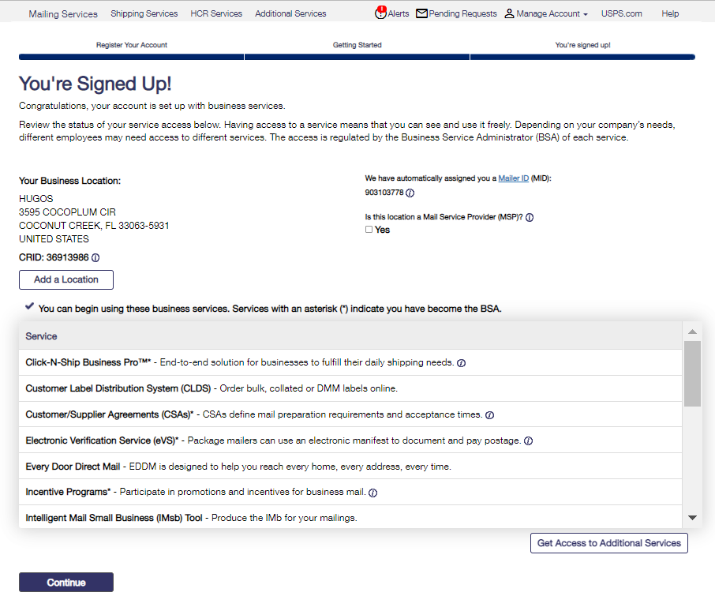
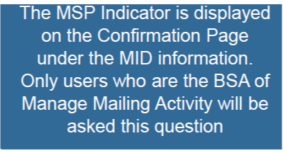
BCG New User Registration
Notes:
Once signed up, you can see your Business Location and CRID along with your Mailer ID or MID. If you are the first user, you are now the BSA of Manage Mailing Activity.
You will have the option to designate a CRID as a Mail Service Provider or MSP if you are an MSP. An MSP is a mail house that provides mailing services to mail owners.
This MSP indicator can be selected at a later time by going to Manage Account>Manage Profile>Edit and scroll to the bottom of the page.
To remove the MSP designator, the BSA must call the MSSC HelpDesk.

Slide 10
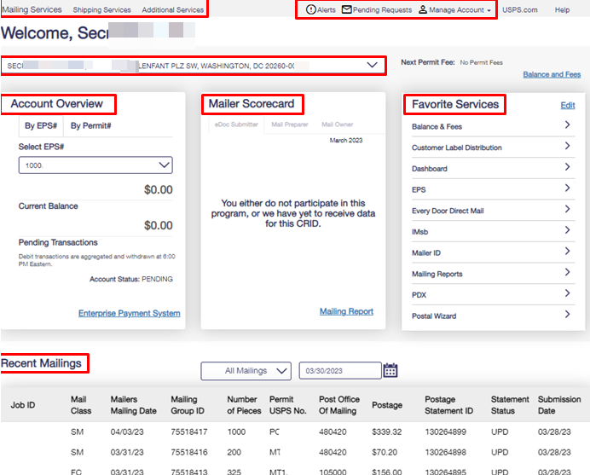
Business Customer Gateway Homepage
Notes:
This is how BCG Welcome page looks.
At the top is the Service Navigation bar. The user can access or request Mailing Services, Shipping Services, and Additional Services.
Alerts is where the Postal Service will post any information that needs to be shared with the customer.
Pending Request is where the BSA will approve their users’ access requests.
Manage Account is a dropdown that allows you to edit your profile and manage your favorites, services, location, and access.
If you have more than one business location or CRID, you will be able to select another business location view using this dropdown. To the right is the Permit Fee amount and due date.
The Account Overview will only display if you have an EPS account.
Next is the mailer scorecard overview. It is available to view the mail quality of electronic mailings of cards, letters, and flats. There is also a link to the mailer scorecard if there is any information in the scorecard. If there is no information in the scorecard, you will see a link to Mailing Report, as we see here.
Then, we have the Favorites Services. Ten favorites can be added for ease of access, such as mailing reports, manage permits, EPS, etc.
The Recent Mailings will show recent mailings pending or finalized.

Slide 11
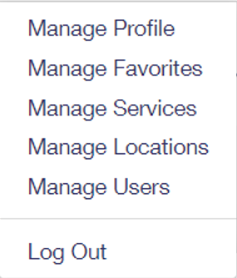
Welcome Page Navigation Bar
Displays system outages and other important information
Business services are now located on the top of the home page
Allows BSAs and BSA delegates to edit their account (see next slide)
Allows users to view, approve, and deny and requests for access to services for which they are the BSA
Notes:
Here is a closer look at the navigation bar. The Service Navigation bar is at the top left.
The Alerts ! will display important information. At this moment we have 2 Active Alerts: We are asking you to please refrain from entering changes to your company's name in the manage profile section of the Business Customer Gateway until August 6, 2023, due to a technical issue. And a reminder that Metallic Mercury and devices containing metallic mercury are always prohibited in the mail stream, including antique items such as thermometers, barometers , blood pressure monitors and similar devices.
Pending requests, is where the BSA will go to approve other users requesting access to the managed CRIDs services.
Manage account, is where the BSA or BSA Delegates can manage their profile, favorite services, business locations and users.

Slide 12
Choose the CRID to View
Allows the user to select the business name and CRID they wish to view
Displays the next time a permit fee is due and the associated amount and the Balance and Fees link
Notes:
Here is the Business Locations dropdown from the Welcome Page, giving the user options to view other locations.
There is also an indicator if any permit fees are due with the dollar amount, due date and the Balance and Fees link. Remember, that fees can be paid via EPS through this link.
If the mailer is Full Service, the fees will not be available for payment if in FS Fee Waiver.

Slide 13
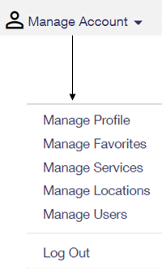
Manage Account Tab
Manage Account Features
Manage Profile
Allows the user to change their account details such as contact information.
Manage Favorites
Edit the ten shortcuts which are visible on the home page.
Manage Services
Allows the viewing of current services and provides the ability to request access to services.
Manage Location
Displays all relevant information about the locations currently set up in the account
Manage Users
Allow BSA and BSA delegates to approve/edit user access
Notes:
Here are the menu options in the Manage Account Drop down.

Slide 14
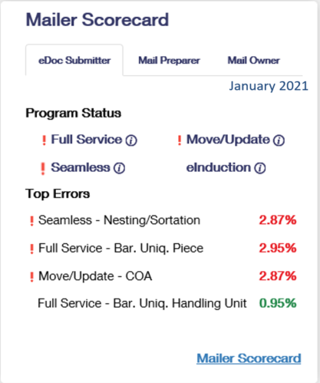
Mailer Scorecard Overview
Tabs allow the letters and flats mailer to choose their view of the scorecard widget
Exclamation marks appear when an indicator within that service is over an error threshold
Displays indicators that are over threshold followed by those that have the highest error percentage
Link to the Mailer Scorecard. Can also be accessed thru Mailing Services → Mailing Reports
14
Notes:
From the home page, the mailer scorecard allows letter, flat and Periodical customers to view their performance when submitting an eDoc. Views can be by eDoc Submitter, Mail Preparer and Mail Owner.
An exclamation mark next to the Programs indicates there are errors exceeding the metric threshold.
Top Errors shows the Program errors with the highest amount over threshold.
There is also a direct link to the mailer scorecard.

Slide 15
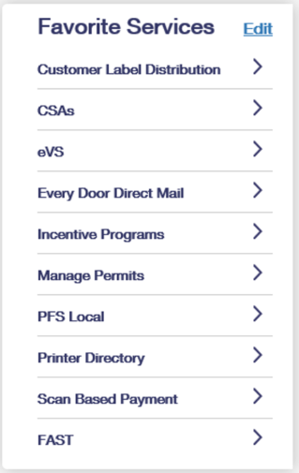
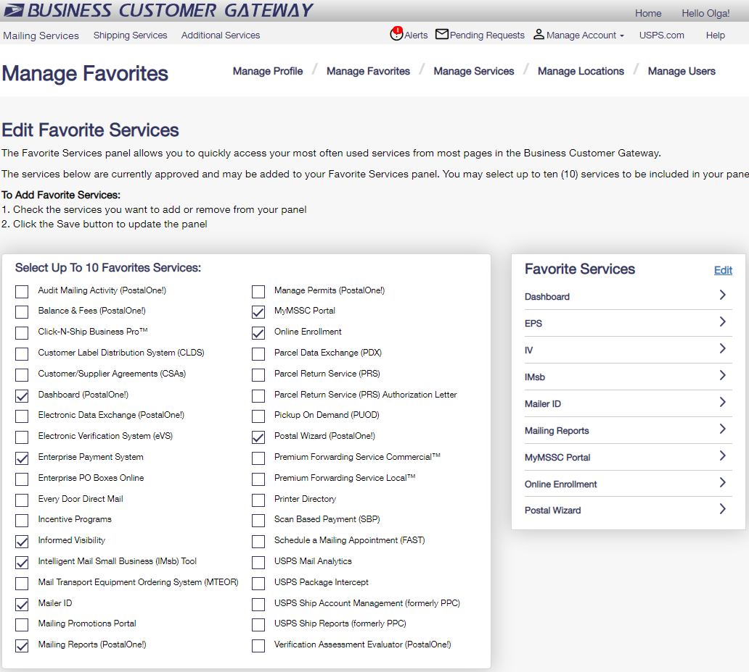
Favorite Services Widget
Allows the user to select up to 10 of their favorite services by clicking on the edit button
Notes:
These are the Manage Favorites options. The user can select up to 10 services and can access the Edit service by clicking on the Edit button on the home page widget OR selecting Mange Account from the home navigation page then going to Manage Favorites.
Only services the user has access to will be listed in the Manage Favorites.

Slide 16
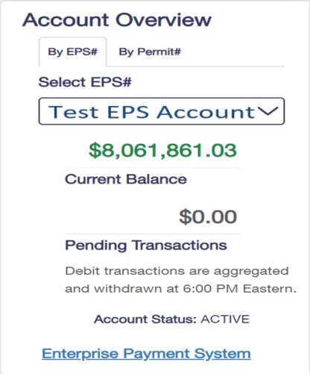
Enterprise Payment Account Overview
Note: to view this widget you must have Manage Mailing Activity (MMA) and at least a Subscriber role in EPS access for the EPS account.
Allows user to select an EPS account they wish to view.
Current Balance shows the amount for a trust account.
Pending Transactions displays the amount to be charged to an ACH debit account.
User can access the EPS from:
EPS the widget link.
Additional Services.
Favorites Services widget.
Account Status: Active or Pending
Notes:
The EPS Account Overview widget on the home page will only display EPS information. The user must be a BSA/Delegate for BCG Manage Mailing Activity and have at least an EPS Subscriber role to view.
The view can be by permit, EPS, view the Trust balance, view the ACH Debit pending transactions. Transactions are aggregated each day at 6pm eastern. This view shows the account status and a link to EPS.

Slide 17
Recent Mailings Widget
Statements are displayed according to a filterable status and date
This widget displays can be expanded to display up to the users ten most recent letter and flat mailings
The recent mailings widget displays up to 10 of your recent letters and flats mailings, for which submitted by eDoc, from the Postalone! dashboard. To view this widget, user must have MMA access.
Notes:
At the bottom of the home page, the recent mailings widget displays up to 10 of your recent letters and flats mailings, for which submitted by eDoc, from the PostalOne! dashboard.
To view this widget, user must have MMA access. Statements are displayed with a filterable status and date

Slide 18
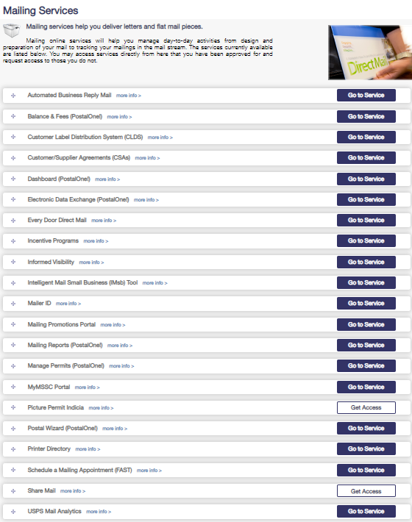
Mailing Services
Commonly used services:
Automated Business Reply Mail Tool
Balance and Fees
CLDS
Dashboard PostalOne!
EDDM
Incentive Programs
Informed Visibility
IMsb Tool
Mailer ID
Mailing Reports
Manage Permits
MyMSSC Portal
Postal Wizard
FAST
Notes:
Here are the most common mailing service requests, which encompass Manage Mailing Activity.
Balance and Fees – with EPS, pay fees; set auto pay feature, fee renewal notice; set low balance alert
PostalOne! Dashboard – view mailings; same as BMEU PostalOne! Dashboard view
IMsb Tool - an online tool which will allow mailers to produce the Intelligent Mail barcode (IMb) for mailings.
Mailer ID – view mailer ID assigned to a business locations and request additional MIDs
Mailing Reports – various PostalOne! reports
Manage Permits – see all permits linked to business location
MyMSSC Portal - Portal for Commercial Mailers to submit inquires on mailing permits, HAZMAT reviews, PostalOne! assistance, ABRM tool assistance, or to submit questions related to commercial mail and mailpiece design.
Postal Wizard – upload mailings electronically - a tool that gives small-volume mailers a secure, electronic means for submitting postage statements and simplifies calculating postage, checking balance and fees, and viewing mailing reports and mailing history. This service is part of Manage Mailing Activity.

Slide 19
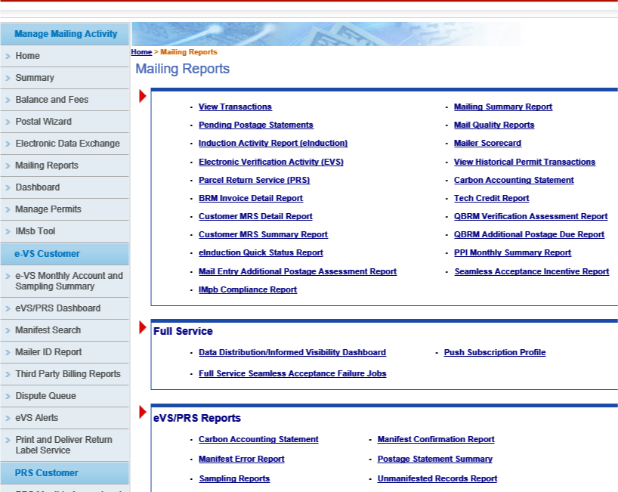
BCG
Balance and Fees
Set low balance alerts for non-EPS permits
Set up auto fee renewal
Set up fee renewal notice
Manage Permits
Lists associated Business Locations/CRID
View all permits, status and PO of permit finance number linked to selected Business Location/CRID
Transactions and BRM Invoice Detail
Search Date range 125 days or less
Transactions only appear for 1 year / 1 month after trans date.
BRM Search up to 365 days for one permit
Notes:
As we mentioned on a previous slide, the Mailing Reports shortcut can be set in the Favorites widget of the BCG Home page for faster access. Otherwise, at the top navigation bar select Mailing Services and scroll to Mailing Reports.
The Mailing Reports page is where mailers have access to various mailing reports. (Review the different reports.)

Slide 20
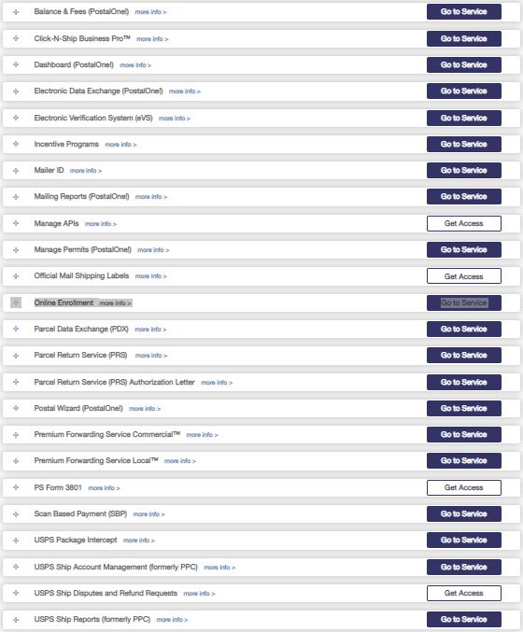
Shipping Services
Commonly used services :
Click-N-Ship® Business Pro
Dashboard PostalOne!
eVS®
Incentive Programs
Mailer ID
Mailing Reports
Manage Permits
Online Enrollment
Postal Wizard®
Premium Forwarding Service (PFS) -Commercial
Premium Forwarding Service (PFS) – Local
USPS Package Intercept
USPS Ship Account Management (formerly PPC)
Notes:
These are all the Shipping Services, as you can see there are also several services Mailing Services.
Online Enrollment - Use Online Enrollment to enroll in these Shipping Services: Electronic Verification System (eVS), Parcel Return Service (PRS), Priority Mail Express Manifesting (PMEM), Tracking Only for Confirmation Services, or Scan Based Payment.
Premium Forwarding Service Commercial™ - Users of premium forwarding service - commercial may redirect mail from one address they to another on a regular schedule, allowing for aggregation of mailings or shipments on a timeline that serves the user's needs.
USPS Package Intercept - Users of premium forwarding service - commercial may redirect mail from one address they to another on a regular schedule, allowing for aggregation of mailings or shipments on a timeline that serves the user's needs.

Slide 21
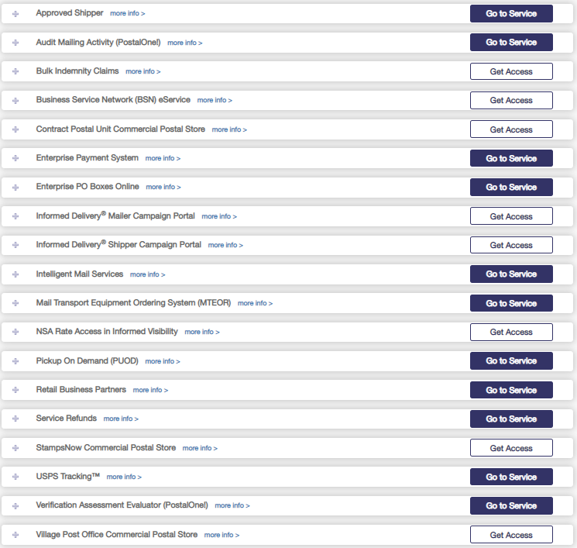
Additional Services
Commonly used services :
Enterprise Payment System
Enterprise PO (ePOBOL)
Informed Delivery® Campaign Portal
Intelligent Mail® Services
Mail Transport Equipment Ordering System (MTEOR)
Pickup On Demand
StampsNow Commercial Postal Store
Notes:
Enterprise Payment System allows USPS customers to setup and manage a centralized and secure payment account. An Enterprise Payment account is linked to an ACH Debit or Trust and allows customers to pay for USPS products and services and view reports.
Enterprise PO Boxes Online - Pay your PO Box, Caller and Reserve fees with your Enterprise Payment Account.
Pickup on Demand service on USPS.com allows customers to conveniently schedule a pickup within a two-hour time frame and pay for it online. The system allows the customer to select a single Pickup on Demand request or reoccurring pickups for up to 1 year.
StampsNow Commercial Postal Store - Provides large mailers access to the online Commercial Postal Store where they can leverage Enterprise Payment as a means of paying for purchases using Trust, ACH and credit cards.

Slide 22
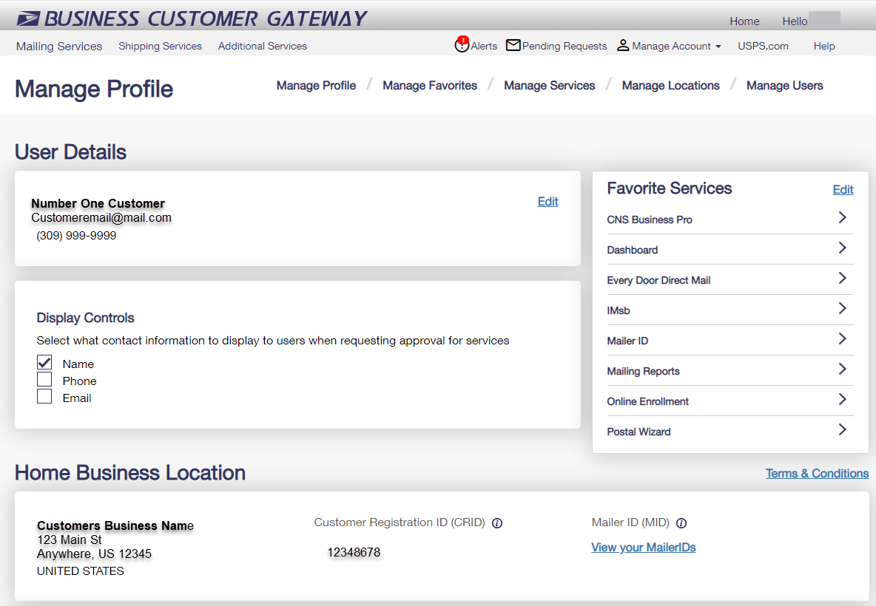
Manage Profile
1. User Details – Edit
Contact info
Change password
Update business address
Change BCG home location
Remove business locations
2. Favorites Services – Edit (10)
3. Home Business Location
View Mailer IDs
Add Business Location
4. Mail Service Providers
Get MID/CRIDs
Customer Validation Tool
2
1
3
3
4
Notes:
Under the Manage Account tab you will find:
Manage Profile
Manage Favorites
Manage Services
Manage Locations
Manage Users
And the Log Out link
In this slide we see the Manage Profile tab, where the BSA can:
Update Contact info
Change password
Update business address
Change BCG home location
Remove business locations
Favorites services user can add up to 10 service they have access to
BSAs can change their BCG Home Business location, view their Mailer IDs, and add other business locations they may need to manage.
If the BSA profiled the BCG as an MSP, they will have the MSP options to get MIDs/or CRIDs for their customers or perform the MSP Balance Check using the Customer Validation Tool.

Slide 23
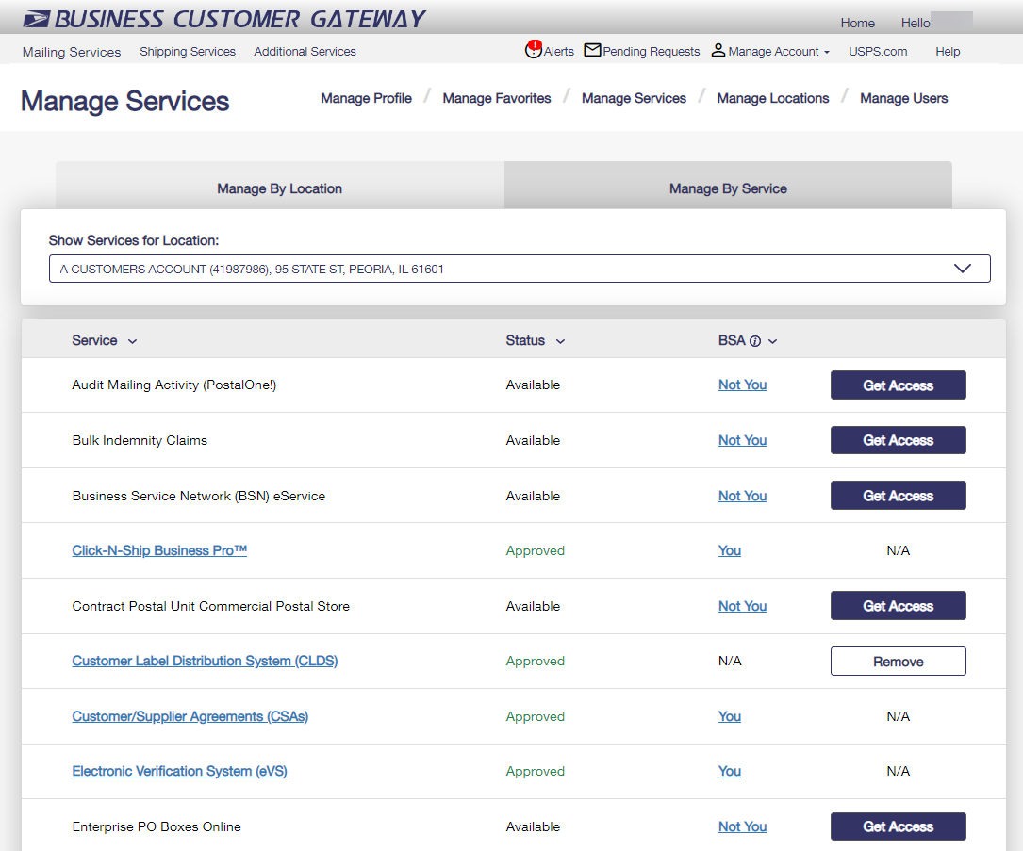
Manage Services
Manage Services by Location or Service.
View the status of each service
Who is the BSA
You
Not You – click on the hyperlink to see current BSA of Service
Get Access
a. Click to Get Access or Remove access to a service
1
2
2
3
3

Slide 24
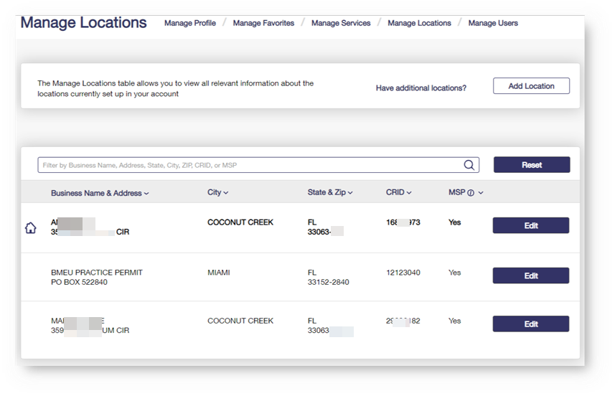
Manage Locations
Allows for additional business locations to be added to BCG
BSA can also edit a business affiliation address or MSP designation
BSA can also Edit the BCG Home Location
1
2
3
123 Main St.

Slide 25
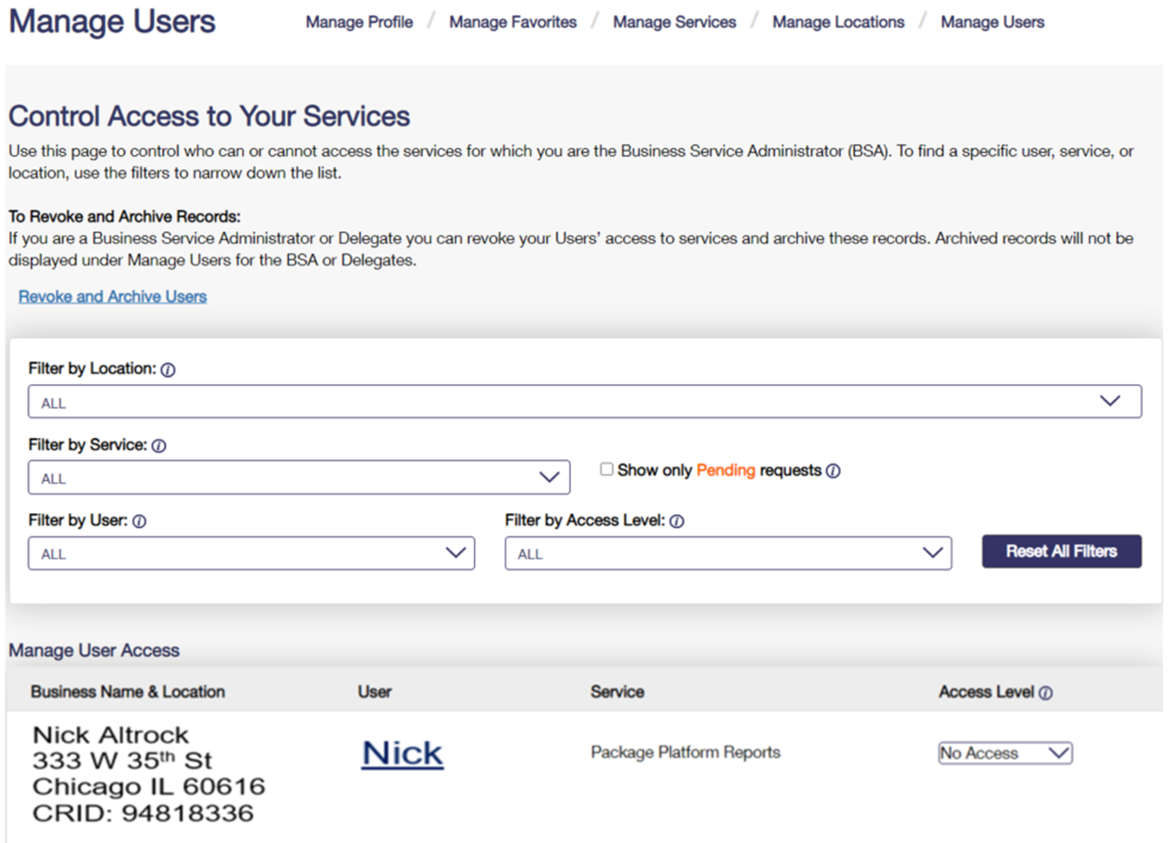
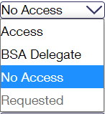
Manage Users
Access: provides user with access to the service for that business location
BSA Delegate allows user to approve/deny requests for that service & location on your behalf
No Access: denies user access to the service for that location
Requested: will default to this when the user has requested access and the BSA has not acted on yet
Notes:
The Business Service Administrator or Delegate can revoke Users’ access to services and archive these records. Once the User is Archived, records will not be displayed under Manage Users for the BSA or Delegates.
From the Access Level dropdown, choose the No Access Level
BSA/Delegate can search for a specific user, service, or location, use the filters to narrow down the list.

Slide 26
Manage Users – Revoke and Archive
Revoke and Archive
This feature allows BSA and BSA delegates to revoke a user from CRID(s) entirely or specific services.
When all services are removed from a user, that user will no longer appear in manage users for their previous BSA.
In cases where the user is not removed from the primary CRID, their access can be restored by returning to revoke and archive and unchecking the boxes next to the users CRID(s) or services

Slide 27
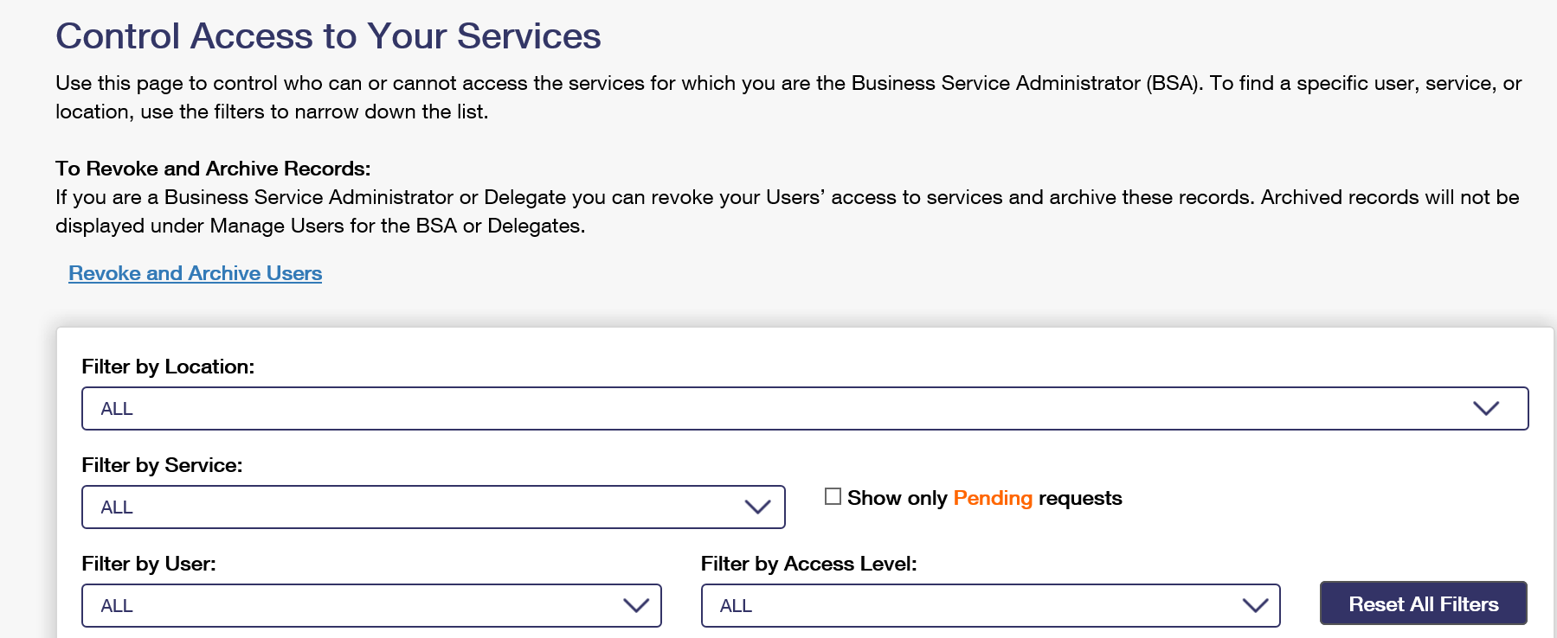
Manage Users – Revoke and Archive
Under manage users, click on revoke and archive
Notes:
So, click the Revoke and Archive Users link.

Slide 28
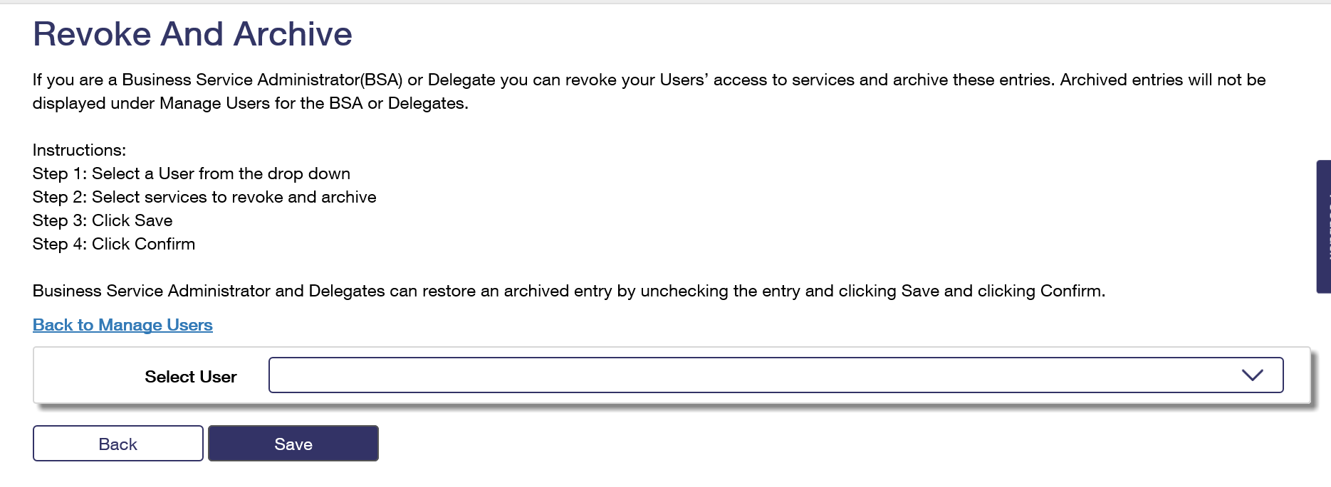
Manage Users – Revoke and Archive
William Pierce
Select the user whose access you wish to change or archive
Notes:
Follow the instructions Step 1 thru Step 4; Select the user

Slide 29
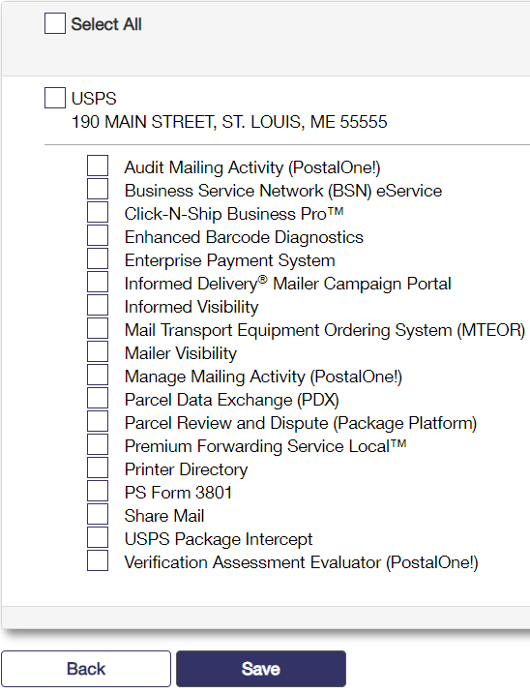
Manage Users – Revoke and Archive
The user and all services assigned to that user appear.
Check the services you wish to revoke and click Save.
In all cases when a service is checked that means it is revoked.
Next click the Save and confirm that this is the action you wish to take.
William Pierce
A checked box means that user or service is archived
Notes:
Once the user is selected, all the service they have access to will appear. Check one, multiple or Select All to remove services.
Any boxes already checked are services that have been removed.

Slide 30
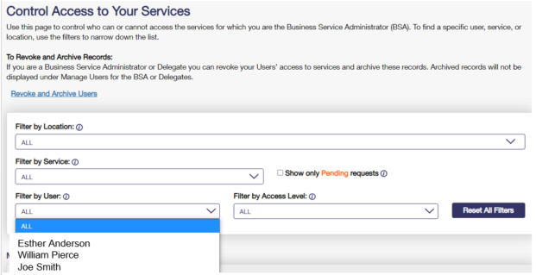
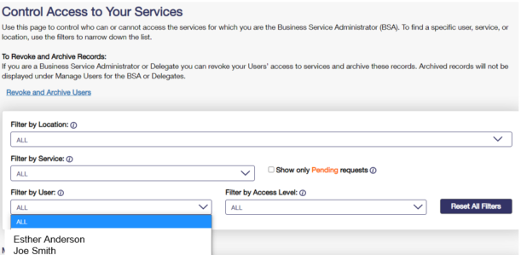
Manage Users – Revoke and Archive
Before all services are removed from William.
After all services are removed from William.
Users will no longer be visible in the Manage Users section after they have been archived.
30
Notes:
On this slide we see how the user’s name appears in the Filter by User dropdown BEFORE services are removed. Then after service are removed, the user no longer appears.
Users will not be visible in Manage Users after they have been archived.

Slide 31
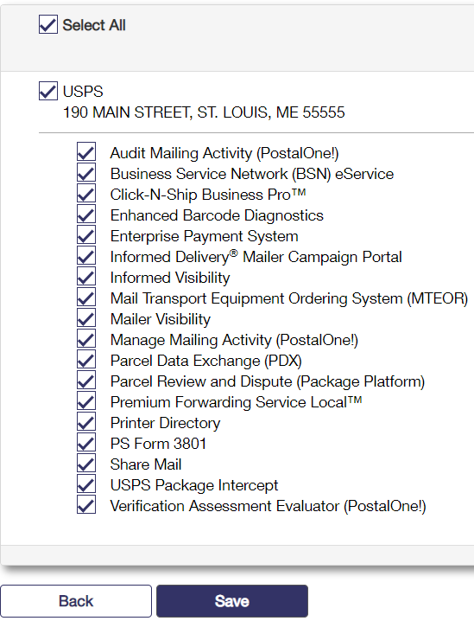
Manage Users – Revoke and Archive
To unarchive a user, uncheck the service you wish to see in Manage Users.
Restoring any or all the services will allow the user to appear on the manage users screen.
If all services were removed from the user or if the user was removed from the main CRID then that user cannot be restored.
Please note: A user who has a service restored will have to be approved for that service again by the BSA. This can be accomplished in Manage Users.
A checked box means that user or service is archived.
31
Notes:
To unarchive a user, uncheck the service you wish to see in Manage Users.
Restoring any or all the services will allow the user to appear on the manage users screen.
If all services were removed from the user or if the user was removed from the main CRID then that user cannot be restored.
Please note: A user who has a service restored will have to be approved for that service again by the BSA. This can be accomplished in Manage Users.

Slide 32
Manage Users – Revoke and Archive
When returning to that user in revoke and archive, those services which were archived appear with check marks
To restore the archived user and records, uncheck the services you would like to return to appear in Manage Users for that user
32
Notes:
To restore the users access, uncheck one, some or Select All to reinstate access.

Slide 33
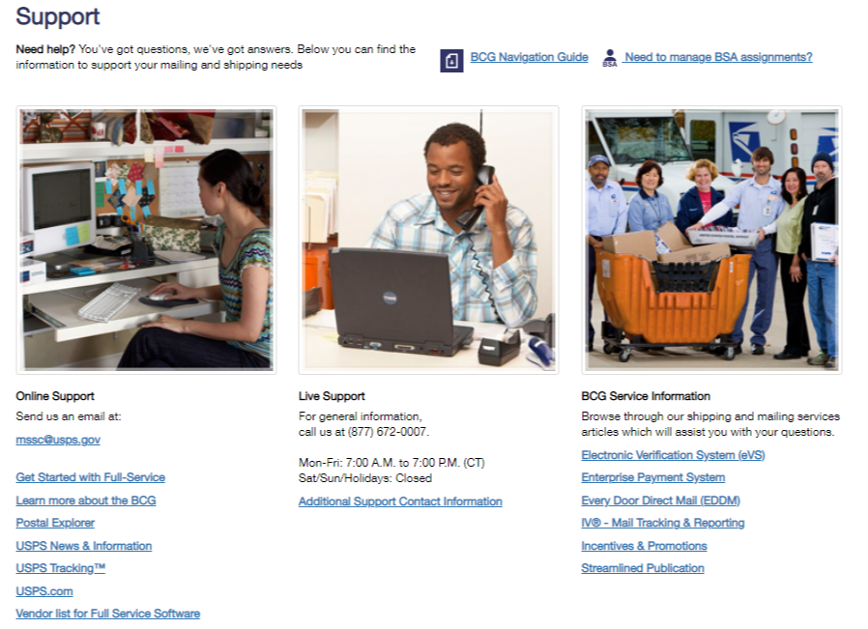
Help Options
Notes:
If you need any assistance navigating the BCG or gaining access to services, click on HELP on the home page of the BCG. It will take you to the support page. Here you will find the BCG Navigation Guide, contact # and emails and a link for instructions to change or update a BSA for a CRID.
When you click on “Need to manage BSA assignments?” it will give you the instructions on how to change or update the BSA for your CRID if you incorrectly become the BSA or if the BSA has left your company.
Did you become the BSA incorrectly? To remove your BSA role, please send your request to the Mailing and Shipping Solutions Center (MSSC) via email at mssc@usps.gov.
The request should be on company letterhead and contain the following information:
CRID and service(s) you would like to be removed as BSA
Contact info
Username
Username of new BSA
Reason for the requested change
Has your BSA left the company? If the BSA for your business location is no longer with the company, and should be transitioned to another user, please send your request to the Mailing and Shipping Solutions Center (MSSC) via email at mssc@usps.gov.
The request should be on company letterhead and contain the following information:
CRID and service(s) for which the BSA should be removed
Username of the new BSA

Slide 34
Postal Wizard
Postage Statement Entry
2023
Notes:
Ok, now to show you how to use one of the services on the BCG, the Postal Wizard. Postal Wizard is an online tool that gives mailers a secure, electronic means for submitting postage statements electronically. Using Postal Wizard eliminates the need for hard-copy postage statements. Users must have a USPS Business Customer Gateway (BCG) Account with an active mailing permit linked to their BCG account

Slide 35
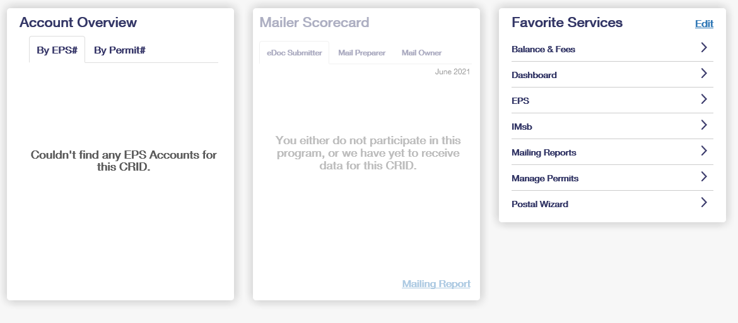
Mailing Services Tab – Select Postal Wizard
Notes:
You can locate Postal Wizard by clicking on the Mailing Services tab. You can also save it as a favorite under Favorite Services.

Slide 36
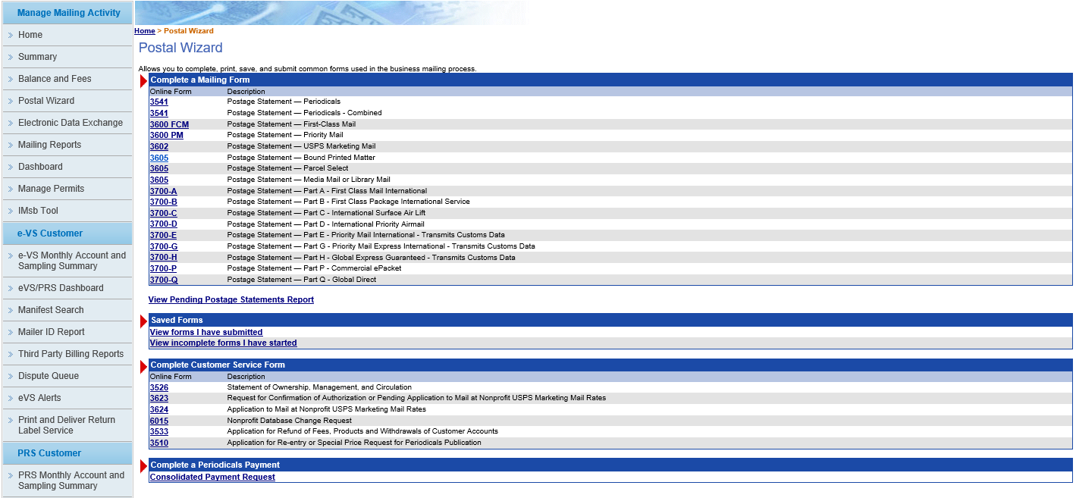
Statement Information – Select Your PS Form
Notes:
All of the available, up-to-date, postage statements are listed. From this page, choose the form number to be completed.

Slide 37
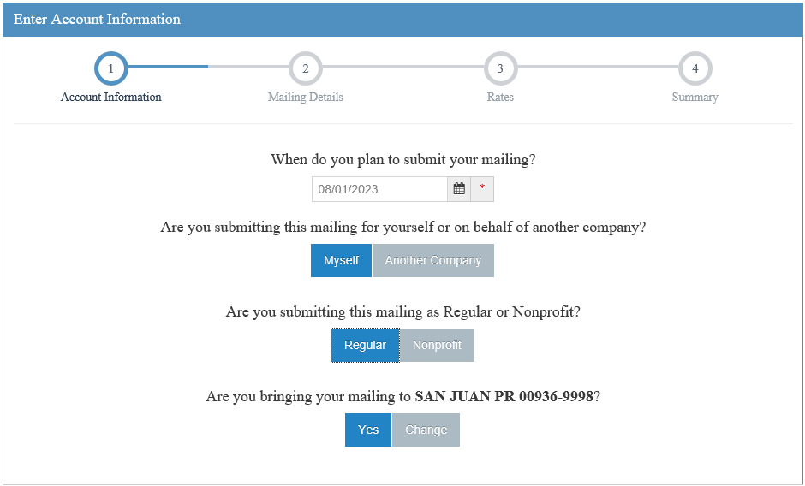
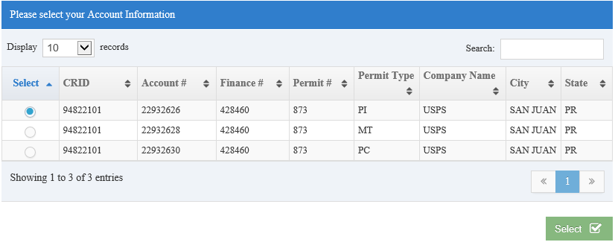
Account Information Selections (Regular/Nonprofit)
Notes:
Next answer these questions. (Read questions in slide.)

Slide 38
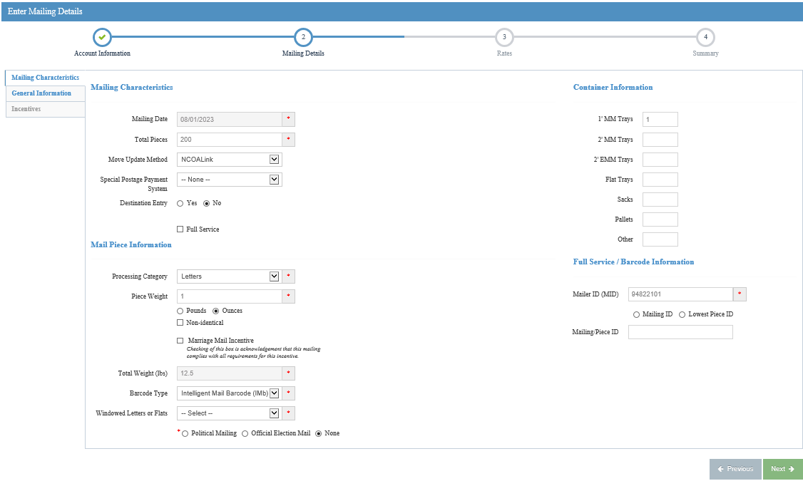
Mailing Characteristics
To document IMb for Full-Service and Non-Full-Service mailings:
Choose Barcode Type
Check box for Full-Service OR Once you have selected the Barcode type it will require the Mailer ID (MID) (non-Full-Service)
Enter 6- or 9-digit Mailer ID
Select Mailing ID if using an identical serial number for all mailpieces in a mailing
Select Lowest Piece ID if applying a range of unique IMb serial numbers throughout the mailing.
Notes:
After answering those questions, you will enter the mailing Characteristics: 200 pieces, Move Update method, Entry discounts, category of mail, number of containers, and weight of single piece.
If the mailpieces are barcoded, you will indicate it by selecting Intelligent Mail Barcode in the Barcode Type, now you will need to enter the applicable MID (which is required for both Full-Service and non Full-Service) and serial # information (which is required only for Full-Service mailings).
The mailer will enter their 6- or 9-Digit Mailer ID.
The mailer has two options for identifying IMbs within a mailing.
If the mailer uses an Identical Barcode Serial Number for every piece within a single mailing, they will select the radio button for Mailing ID.
If the mailer is going to apply a range of unique IMb serial numbers throughout the mailing, they will select the radio button for Lowest Piece ID and enter the lowest piece IMb range. The field for Highest Piece ID will auto populate once the lowest has been entered.
Click continue.
Remember to follow DMM 203.2 on required documentation for barcoded mail pieces.

Slide 39
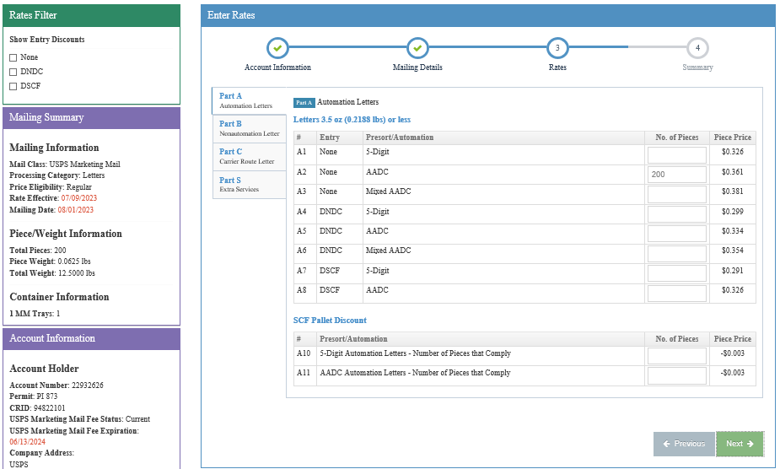
Rates – Enter Piece Counts
Enter piece counts on the proper price lines. Verify info on the left side.
Notes:
Now, enter your pieces on the appropriate price line depending on the sortation of the mailing. Click next.

Slide 40
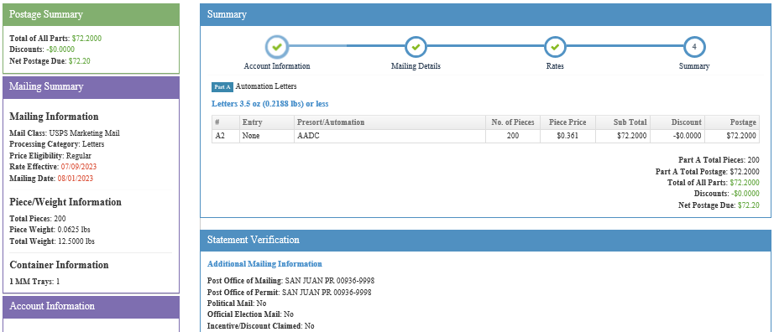
Summary Screen – Verify Information
Notes:
The mailing is totaled. Review your entries and make sure everything has been entered accurately. If not, go back and make corrections.

Slide 41
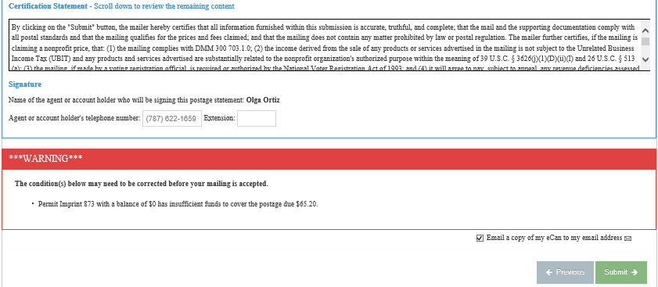
Statement Submission – Read Certification Statement and Submit
Notes:
Scroll to bottom of the summary page, read certification statement and click submit. You will get the confirmation page

Slide 42
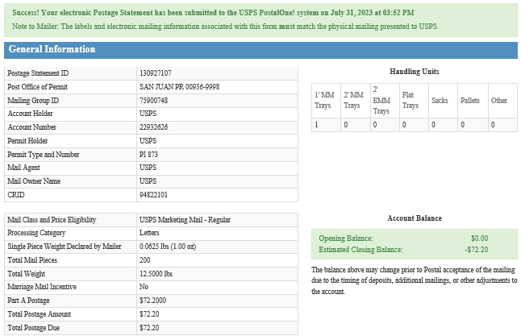
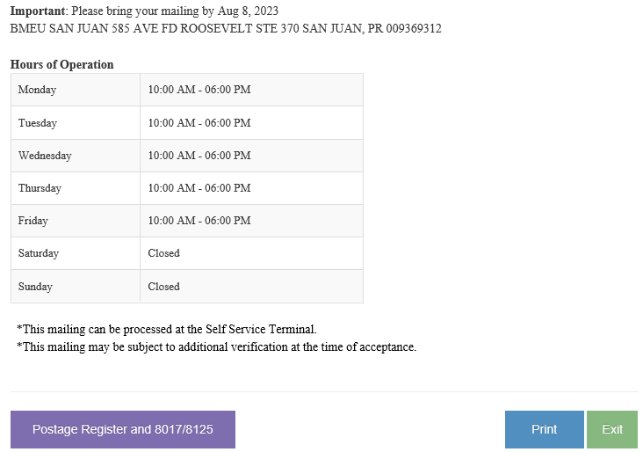
Confirmation Page
Notes:
Success! Your electronic Postage Statement has been submitted to the USPS PostalOne! system on it will have the date and time of submission.
Note to Mailer: The labels and electronic mailing information associated with this form must match the physical mailing presented to USPS

Slide 43
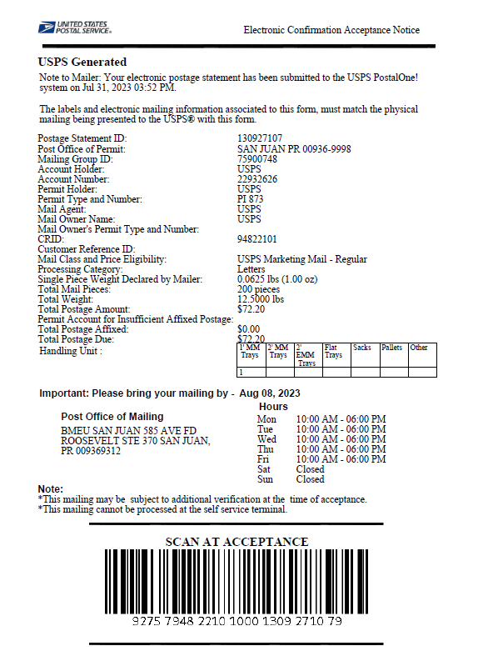
Confirmation Page
Print the confirmation page and present it with your mailing at the acceptance office.
Notes:
Print this page and bring with your mail to the BMEU. If the BMEU has a Self-Service Terminal (SST), you can check in your mailing by scanning the barcode on this page.
If you have over 10,000 pieces, submit your qualification report with the confirmation page. If you submit a job in error, you can navigate to your dashboard and cancel a statement. You are not charged any postage until the mail is presented or the statement has been finalized.

Slide 44
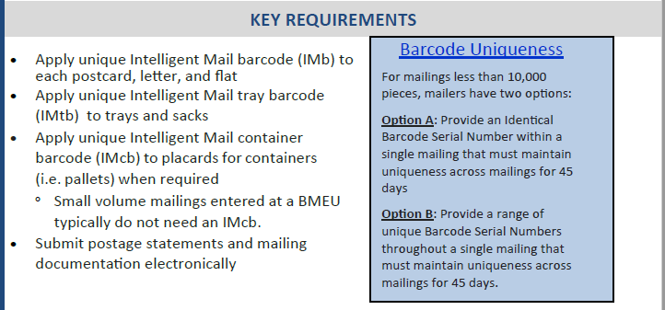
Full-Service
All mailers are encouraged to submit their postage statements electronically, but eDoc is a requirement for Full-Service Intelligent Mail® and Seamless Acceptance.
Full-Service Intelligent Mail® Fact Sheet | PostalPro (usps.com)
Notes:
All mailers are encouraged to submit their postage statements electronically, but eDoc is a requirement for Full-Service Intelligent Mail® and Seamless Acceptance.
Mailers still submitting hard copy postage statements to your BME are not taking advantage of mail piece discounts for full service or annual permit fee waivers.
eDoc is the steppingstone to Full-Service and then ultimately Seamless status. Seamless mailers also have the additional $.001/pc discount if they have an EPS account linked to their permit. All of these discounts add up to a potential savings of hundreds (or even thousands ) of dollars a year in postage costs. By using eDoc, bulk mailing becomes more affordable and a greater value to our customers, encouraging them to submit more bulk mailings. More volume is good for the USPS and its employees.

Slide 45
Resources
Postal Wizard Fact Sheet | PostalPro (usps.com)
How to Submit a Postal Wizard Mailing
A Guide to Full Service (including Postal Wizard)
Electronic Documentation (eDoc) Fact Sheet | PostalPro (usps.com)
How to Submit Mail.dat Jobs to PostalOne!
How to Submit Mail.XML Jobs to PostalOne!
USPS Technical Specifications for Mail.dat and Mail.XML
For additional questions, please reach out your local BME or to the Mailing and Shipping Solutions Center (MSSC).
1-877-672-0007
mssc@usps.gov
Notes:
Here are some resources. This presentation will be posted in PostalPro.
The links in this presentation are live.
After any Q&A we will go into the BCG to see how easy it is to submit a postage statement via PW.

Slide 46
®
Questions?
Notes:
Any questions? We can now go into the Business Customer Gateway and do a live demo.

